Slide 1
Predicting Turbidity
Robert Bentz, Colleen Karwoski, Laura Murray, Eugenia Volscaia and Katelyn Walsh

Slide 2
Turbidity: the measure of relative clarity of a liquid.
It is an optical characteristic of water and is a measurement of the amount of light that is scattered by material in the water when a light is shined through the water sample. The higher the intensity of scattered light, the higher the turbidity.
Source: usgs.gov/special-topics

Slide 3
Why Turbidity Matters
High concentrations of particulate matter affect light penetration and ecological productivity, recreational values, and habitat quality, and cause lakes to fill in faster.
In streams, increased sedimentation and siltation can occur, which can result in harm to habitat areas for fish and other aquatic life.
Particles also provide attachment places for other pollutants, notably metals and bacteria.
For this reason, turbidity readings can be used as an indicator of potential pollution in a water body.
Source: usgs.gov/special-topics

Slide 4
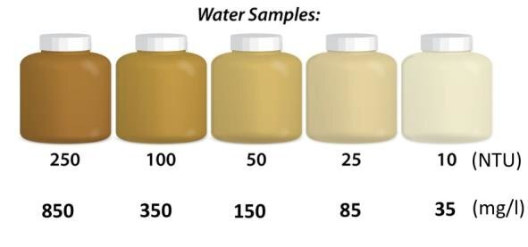
Turbidity Measurements
In our data range the chosen measurement for turbidity is nephelometric turbidity units (NTU) and is measurement by a 6600 series sondes.
Source: usgs.gov/special-topics

Slide 5
Available Water Quality Data
Parameters and units
Temp:Water temperature measured in degrees Celsius (C).
SpCond:Specific conductivity measured in milli-Siemens per centimeter (mS/cm).
Sal:Salinity measured in practical salinity units (psu).
DO_pct:Dissolved oxygen measured in percent saturation (%).
DO_mgl:Dissolved oxygen concentration measured in milligrams per Liter (mg/L).
Depth:Sonde depth measured in meters (m).
cDepth:Depth from a non-vented sensor corrected for changes in barometric pressure (m).
Level:Sonde depth as referenced to a known vertical datum, NAVD88, measured in meters (m). Note: vertical control is established by different means across the system, please see the metadata provided with each station’s data download for station specifics and to determine if data are suitable for your use.
cLevel:Level from a non-vented sensor corrected for changes in barometric pressure (m).
pH:pH measured in standard units.
Turb:Turbidity measured in either formazin nephelometric or nephelometric turbidity units (FNU/NTU) based on sensor, considered to be equivalent for SWMP purposes.
ChlFluor:Chlorophyll fluorescence measured in micrograms per Liter (ug/L)*.
*ChlFluor is an optional SWMP supported parameter
Source: NOAA National Estuarine Research Reserve System (NERRS). System-wide Monitoring Program. Data accessed from the NOAA NERRS Centralized Data Management Office website: http://www.nerrsdata.org; accessed 1 June 2023.

Slide 6
Available Nutrient and Pigment Data
Parameters and units*
PO4F Orthophosphate measured in milligrams per Liter (mg/L) as P.
NH4F Ammonium measured in milligrams per Liter (mg/L) as N.
NO2F Nitrite measured in milligrams per Liter (mg/L) as N.
NO3F Nitrate measured in milligrams per Liter (mg/L) as N.
NO23F Nitrite + nitrate measured in milligrams per Liter (mg/L) as N.
CHLA_N Chlorophyll a measured in micrograms per Liter (ug/L).
*Numerous optional SWMP supported parameters are accepted and available in the yearly data files
Source: NOAA National Estuarine Research Reserve System (NERRS). System-wide Monitoring Program. Data accessed from the NOAA NERRS Centralized Data Management Office website: http://www.nerrsdata.org; accessed 1 June 2023.

Slide 7
Available Meteorological Data
Parameters and units
Frequency:15 minute collection interval. Prior to 2007, frequencies for 60 (hourly) and 144 (daily) averages were also reported.
ATemp:Average air temperature measured in degrees Celsius (C).
RH:Average relative humidity measured in percent saturation (%).
BP:Average barometric pressure measured in millibars (mb).
WSpd:Average wind speed measured in meters per second (m/s).
MaxWSpd:Max wind speed measured in meters per second (m/s).
MaxWSpdT:Time of max wind speed measurement (hh:mm).
Wdir:Average direction from which the wind originates measured in degrees from true North as of April 1, 2008. Prior to April 1, 2008 wind direction was measured with no correction for magnetic declination. See Reserve metadata for exact date of shift to true North.
SDWDir:Wind direction standard deviation (sd).
TotPAR:Photosynthetically active radiation measured in millimoles per square meter (total flux integrated - totalized - over each 15 minute logging interval).
TotPrcp:Total precipitation measured in millimeters (mm).
CumPrcp:Cumulative precipitation measured in millimeters (mm) over a 24 hour period. Note that data reported at the midnight timestamp (00:00) are the sum of raw (unrounded) precipitation data from 00:00 to 23:59 of the previous day.*
TotSoRad:15 minute average of total solar radiation measured in watts per square meter.**
Source: NOAA National Estuarine Research Reserve System (NERRS). System-wide Monitoring Program. Data accessed from the NOAA NERRS Centralized Data Management Office website: http://www.nerrsdata.org; accessed 1 June 2023.

Slide 8
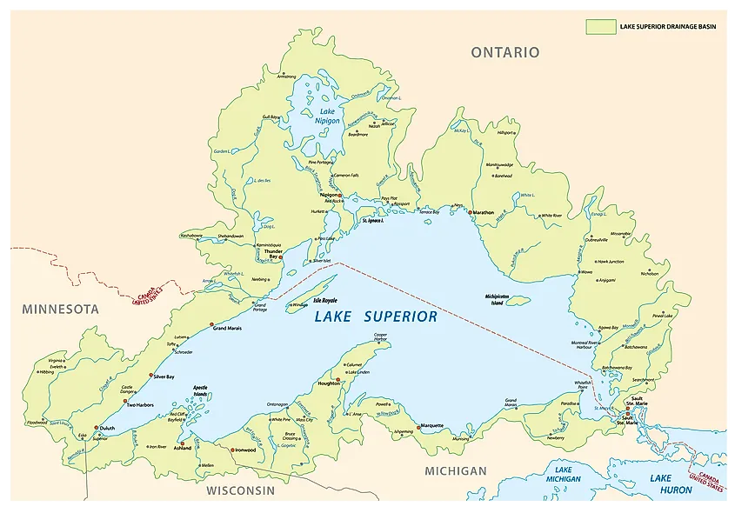
Predicting Turbidity in Lake Superior
Lake Superior is the largest and most spectacular body of water bordering Minnesota. Our team wanted to look into the water quality of Lake Superior. We chose to predict turbidity because high turbidity can significantly reduce the aesthetic quality of any body of water.
Source: worldatlas.com

Slide 9
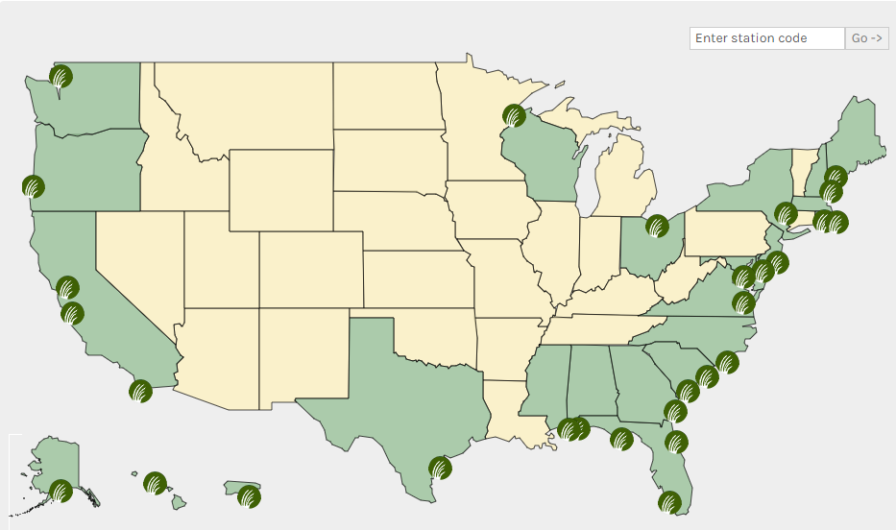
Data Source
National Oceanic and Atmospheric Administration’s (NOAA) National Estuarine Research Reserve System (NERRS) identifies and tracks short-term variability and long-term changes in the integrity and biodiversity of representative estuarine ecosystems and coastal watersheds. The purpose of NERRS is to contribute to the effective national, regional and site-specific coastal zone management of estuary sites (where rivers enter coastal waters).
Our team chose to look at water quality at the Barker’s Island station with weather data from the Pokegama Bay in Lake Superior.
Source: NOAA National Estuarine Research Reserve System (NERRS). System-wide Monitoring Program. Data accessed from the NOAA NERRS Centralized Data Management Office website: http://www.nerrsdata.org; accessed 1 June 2023.

Slide 10
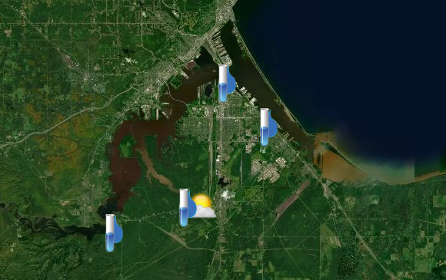
Lake Superior Monitoring Stations
Pokegama Bay is the only station on Lake Superior that collects meteorological data. We chose Barker’s Island for the water quality and nutrient data because we thought it would have the most human disruption. A wastewater treatment plant, a cement factory and municipal storm drain are nearby.
Blatnik Bridge
Barker’s Island
Pokegama Bay
Oliver Bridge
Source: NOAA National Estuarine Research Reserve System (NERRS). System-wide Monitoring Program. Data accessed from the NOAA NERRS Centralized Data Management Office website: http://www.nerrsdata.org; accessed 1 June 2023.

Slide 11
Data Cleaning
NERR online data query request
NERR emails CSV data link to download data
Load CSV dataset
Jupyter Notebook using Python, PySpark,
Pandas
Optimize models for best results
Analyze clean CSV tables using KNN and Random Forest
Remove outliers from CSV dataset by query
Retaining the data with valid quality codes.

Slide 12
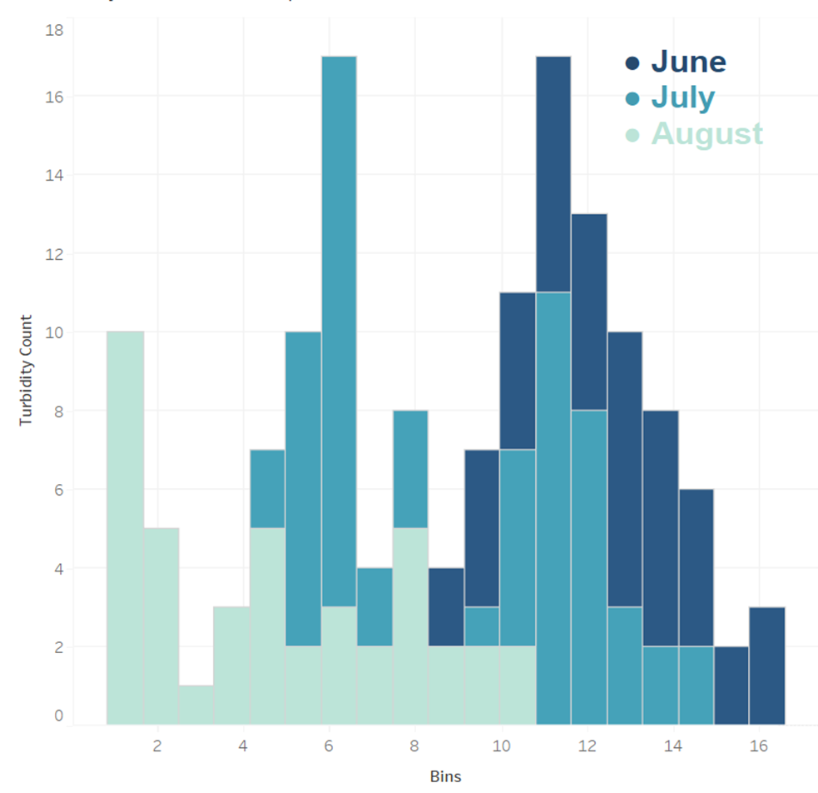
Data Preprocessing
Months with most representative data:
June
July
August
Bin distribution chosen for models:
<=5
<=10
<=15

Slide 13
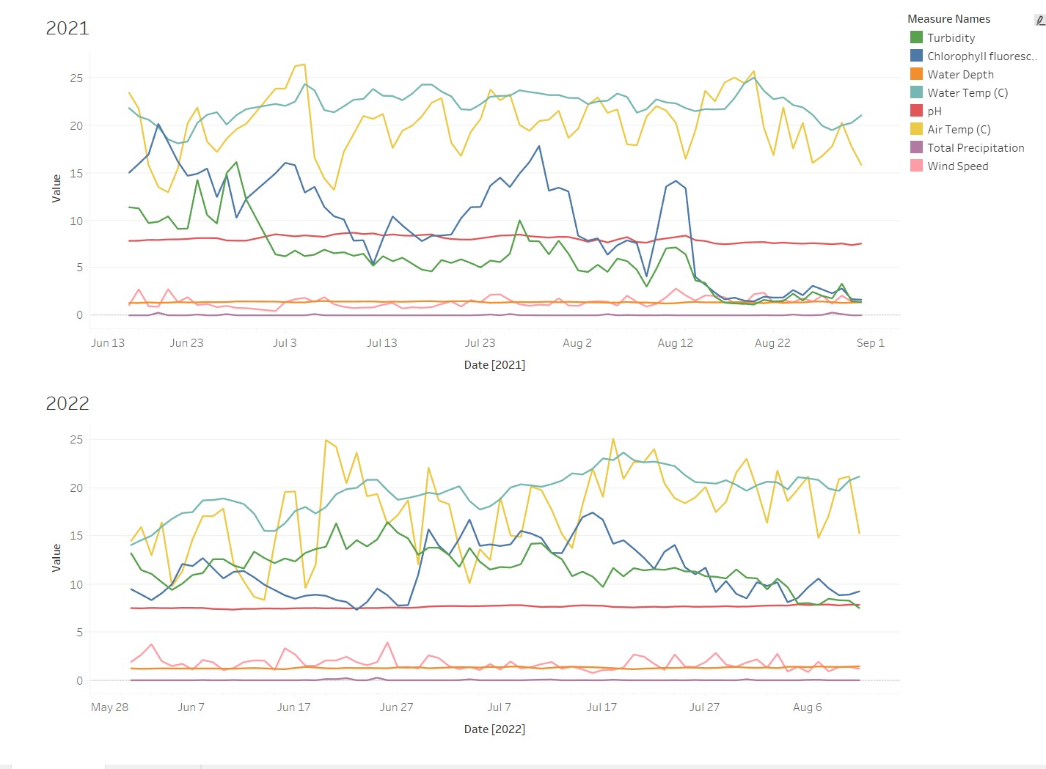
Data Features
Graphs were created in tableau
from summer_groupby_date.csv

Slide 14
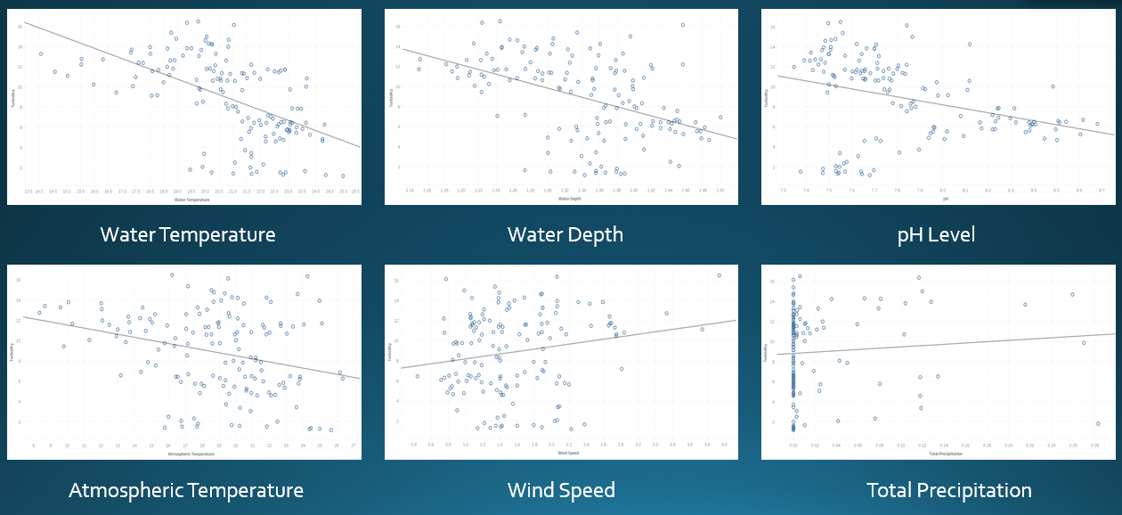
Model 1 Features

Slide 15
Predictive Model Question
Does turbidity require its own measurement or can it be determined by other features from the water quality and meteorological data sets?
Question impact:
Understanding the relationship of data features
Influence approach and prioritization of features measured
Source: usgs.gov/special-topics

Slide 16
Model Data Files
Model 1 | Cleaned Data - refined from metadata Daily Average Summer Months (June, July, August) Three bins in model
Model 2
Model 3
Feature Refinement
Model 4 | Cleaned Data - refined from metadata Non-aggregated, all timestamp values Summer Months (June, July, August) Six bins in model
Source: NOAA National Estuarine Research Reserve System (NERRS). System-wide Monitoring Program. Data accessed from the NOAA NERRS Centralized Data Management Office website: http://www.nerrsdata.org; accessed 1 June 2023.

Slide 17
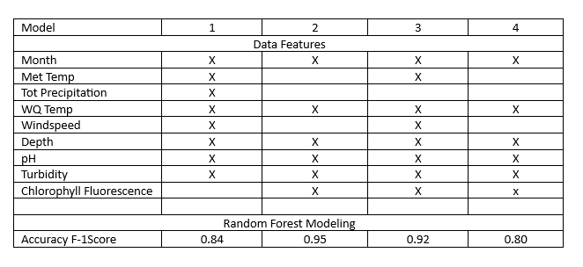
Random Forest Model
Source: NOAA National Estuarine Research Reserve System (NERRS). System-wide Monitoring Program. Data accessed from the NOAA NERRS Centralized Data Management Office website: http://www.nerrsdata.org; accessed 1 June 2023.

Slide 18
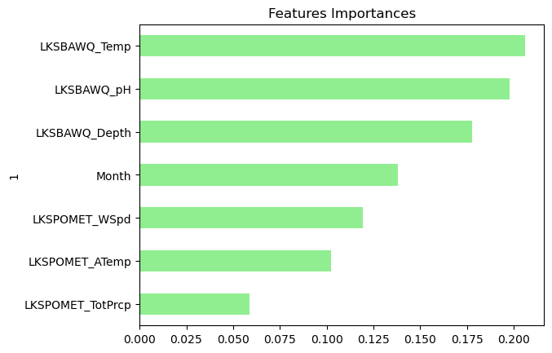
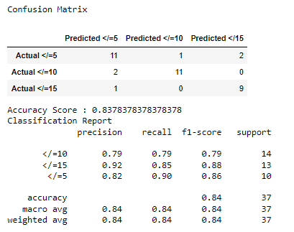
Random Forest Model 1
The first model included meteorological data and water quality data with features we selected as a group for our initial set.
*LKSBAWQ = Lake Superior Barkers Island Water Quality
*LKSMET = Lake Superior Meteorological Data
*ChlFluor = Chlorophyll Fluorescence
Source: NOAA National Estuarine Research Reserve System (NERRS). System-wide Monitoring Program. Data accessed from the NOAA NERRS Centralized Data Management Office website: http://www.nerrsdata.org; accessed 1 June 2023.

Slide 19
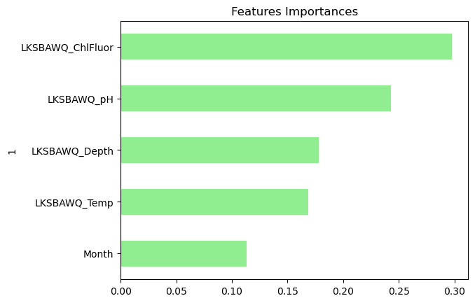
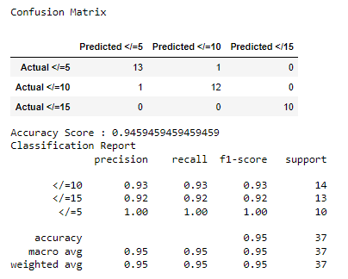
Random Forest Model 2
The second model dropped the least important features, added the feature of chlorophyll fluorescence and that excluded the meteorological data.
*LKSBAWQ = Lake Superior Barkers Island Water Quality
*ChlFluor = Chlorophyll Fluorescence
Source: NOAA National Estuarine Research Reserve System (NERRS). System-wide Monitoring Program. Data accessed from the NOAA NERRS Centralized Data Management Office website: http://www.nerrsdata.org; accessed 1 June 2023.

Slide 20
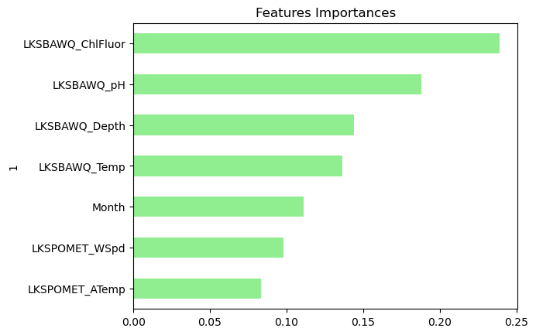
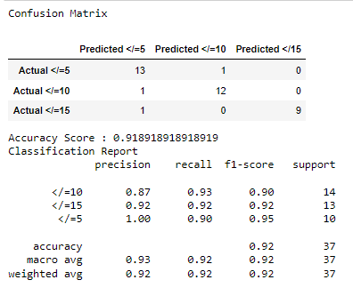
Random Forest Model 3
After seeing the influence of the chlorophyll fluorescence we added back the meteorological data to see if they had an impact with the newly added feature.
*LKSBAWQ = Lake Superior Barkers Island Water Quality
*LKSMET = Lake Superior Meteorological Data
*ChlFluor = Chlorophyll Fluorescence
Source: NOAA National Estuarine Research Reserve System (NERRS). System-wide Monitoring Program. Data accessed from the NOAA NERRS Centralized Data Management Office website: http://www.nerrsdata.org; accessed 1 June 2023.

Slide 21
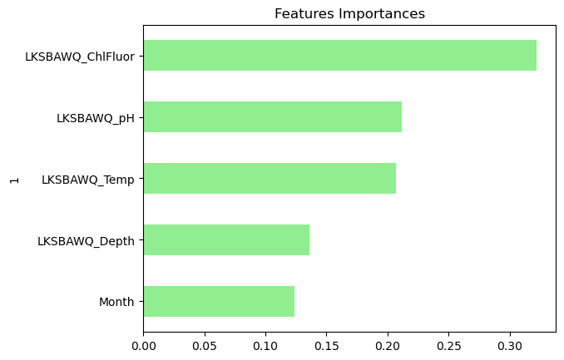
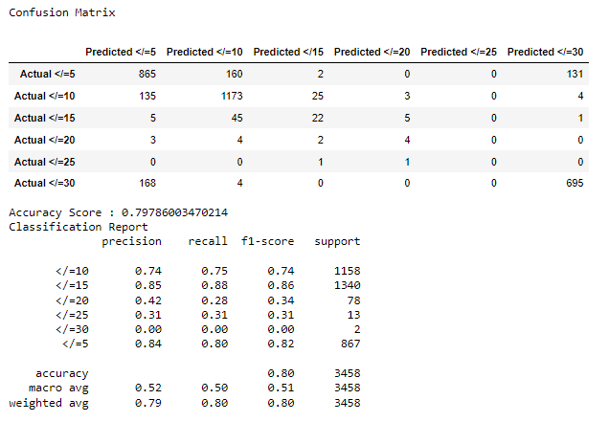
Random Forest Model 4
Our fourth model takes all of the summer measurement values rather than taking the daily average. It has a broader range of turbidity levels but a lower accuracy.
*LKSBAWQ = Lake Superior Barkers Island Water Quality
*ChlFluor = Chlorophyll Fluorescence
Source: NOAA National Estuarine Research Reserve System (NERRS). System-wide Monitoring Program. Data accessed from the NOAA NERRS Centralized Data Management Office website: http://www.nerrsdata.org; accessed 1 June 2023.

Slide 22
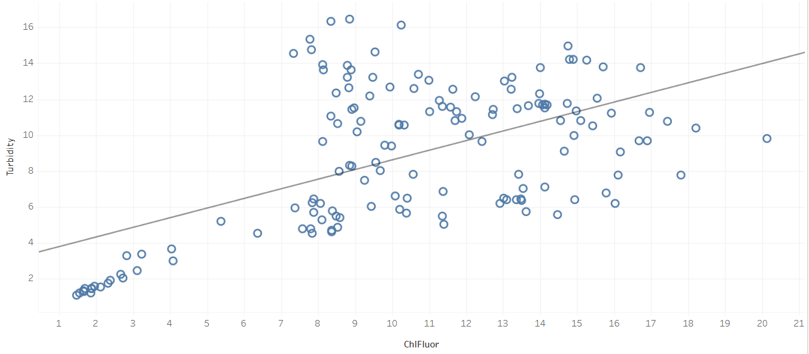
Chlorophyll Fluorescence Feature
r_squared = 0.323282
p-value < 0.0001
Chlorophyll is the compound present in green plants that gives them their color and is responsible for energy production.
Chlorophyll Fluorescence is a measurement of light that is calculated into the chlorophyll quantity.
The amount of Chlorophyll Fluorescence in a lake is one of the factors that affect turbidity; high amount of Chlorophyll Fluorescence can lead to high turbidity.

Slide 23
Predictive Model Question
Does turbidity require its own measurement or can it be determined by other features from the water quality and meteorological data sets?
We found a high accuracy with the models supporting three bins with aggregated data.
We found a larger range of bin values with the non-aggregated data but it resulted in a lower accuracy.
Recommendation: the features of chlorophyll fluorescence, pH, depth, temp, and month can predict the level of turbidity at a high level but we would not trust the accuracy of predicting at a more precise level.
Source: usgs.gov/special-topics

Slide 24
Further Reading
https://www.epa.gov/awma/factsheets-water-quality-parameters
https://www.epa.gov/system/files/documents/2022-01/list-of-state-specific-water-quality-standards.pdf
https://www.epa.gov/wqs-tech/state-specific-water-quality-standards-effective-under-clean-water-act-cwa
https://www.epa.gov/awma/factsheets-water-quality-parameters
https://www.epa.gov/wqs-tech/state-specific-water-quality-standards-effective-under-clean-water-act-cwa
https://www.epa.gov/system/files/documents/2021-07/parameter-factsheet_turbidity.pdf
https://www.pca.state.mn.us/air-water-land-climate/cleaning-up-the-st-louis-river
https://www.pca.state.mn.us/sites/default/files/wq-iw3-21.pdf

Slide 25

JASON
CHARLA
SERGIO
XARA

Slide 26

QUESTIONS

Slide 27
Appendix

Slide 28
Quality Assurance and Quality Control
QC Flags
Each parameter in the exported data file contains a flag column. The flag column, F_param, contains a quality control (QC) flag and may contain additional QC codes. In a chart mouse-over, the QAQC flag and any codes are displayed behind the F_param: designation. Refer to the list below for the available QC flags and their descriptions.
-5 Outside high sensor range
-4 Outside low sensor range
-3 Data rejected due to QAQC
-2 Missing data
-1 Optional parameter not collected
0 Passed initial QAQC checks
1 Suspect data
2 Reserved for future use
3 Calculated data: non-vented depth/level sensor correction for changes in barometric pressure
4 Historical: Pre-auto QAQC
5 Corrected data
Source: NOAA National Estuarine Research Reserve System (NERRS). System-wide Monitoring Program. Data accessed from the NOAA NERRS Centralized Data Management Office website: http://www.nerrsdata.org; accessed 1 June 2023.

Slide 29
QC Codes by Water Quality Dataset
General Errors
GIC No instrument deployed due to ice
GIM Instrument malfunction
GIT Instrument recording error; recovered telemetry data
GMC No instrument deployed due to maintenance/calibration
GNF Deployment tube clogged / no flow
GOW Out of water event
GPF Power failure / low battery
GQR Data rejected due to QAQC checks
GSM See metadata
Corrected Depth/Level Data Codes
GCC Calculated with data that were corrected during QAQC
GCM Calculated value could not be determined due to missing data
GCR Calculated value could not be determined due to rejected data
GCS Calculated value suspect due to questionable data
GCU Calculated value could not be determined due to unavailable data
Sensor Errors
SBO Blocked optic
SCF Conductivity sensor failure
SCS Chlorophyll spike
SDF Depth port frozen
SDG Suspect due to sensor diagnostics
SDO DO suspect
SDP DO membrane puncture
SIC Incorrect calibration / contaminated standard
SNV Negative value
SOW Sensor out of water
SPC Post calibration out of range
SQR Data rejected due to QAQC checks
SSD Sensor drift
SSM Sensor malfunction
SSR Sensor removed / not deployed
STF Catastrophic temperature sensor failure
STS Turbidity spike
SWM Wiper malfunction / loss
Comments
CAB* Algal bloom
CAF Acceptable calibration/accuracy error of sensor
CAP Depth sensor in water, affected by atmospheric pressure
CBF Biofouling
CCU Cause unknown
CDA* DO hypoxia (<3 mg/L)
CDB* Disturbed bottom
CDF Data appear to fit conditions
CFK* Fish kill
CIP* Surface ice present at sample station
CLT* Low tide
CMC* In field maintenance/cleaning
CMD* Mud in probe guard
CND New deployment begins
CRE* Significant rain event
CSM* See metadata
CTS Turbidity spike
CVT* Possible vandalism/tampering
CWD* Data collected at wrong depth
CWE* Significant weather event
*Indicates comments that can be applied to an entire record in the F_Record column.
Source: NOAA National Estuarine Research Reserve System (NERRS). System-wide Monitoring Program. Data accessed from the NOAA NERRS Centralized Data Management Office website: http://www.nerrsdata.org; accessed 1 June 2023.

Slide 30
QC Codes by Meteorological Dataset
GIM Instrument malfunction
GIT Instrument recording error, recovered telemetry data
GMC No instrument deployed due to maintenance/calibration
GMT Instrument maintenance
GPD Power down
GPF Power failure / low battery
GPR Program reload
GQR Data rejected due to QAQC checks
GSM See metadata
Sensor Errors
SDG Suspect due to sensor diagnostics
SIC Incorrect calibration constant, multiplier or offset
SIW Incorrect wiring
SMT Sensor maintenance
SNV Negative value
SOC Out of calibration
SQR Data rejected due to QAQC checks
SSD Sensor drift
SSN Not a number / unknown value
SSM Sensor malfunction
SSR Sensor removed
Comments
CAF Acceptable calibration/accuracy error of sensor
CCU Cause unknown
CDF Data appear to fit conditions
CML Snow melt from previous snowfall event
CRE* Significant rain event
CSM* See metadata
CVT* Possible vandalism/tampering
CWE* Significant weather event
*Indicates comments that can be applied to an entire record in the F_Record column.
Source: NOAA National Estuarine Research Reserve System (NERRS). System-wide Monitoring Program. Data accessed from the NOAA NERRS Centralized Data Management Office website: http://www.nerrsdata.org; accessed 1 June 2023.

Slide 31
QC Codes by Nutrient Dataset
General errors
GCM Calculated value could not be determined due to missing data
GCR Calculated value could not be determined due to rejected data
GDM Data missing or sample never collected
GQD Data rejected due to QAQC checks
GQS Data suspect due to QAQC checks
GSM See metadata
Sensor errors
SBL Value below minimum limit of method detection
SCB Calculated value could not be determined due to a below MDL component
SCC Calculation with this component resulted in a negative value
SNV Calculated value is negative
SRD Replicate values differ substantially
SUL Value above upper limit of method detection
Record comments (in addition to those with asterisks above)
Cloud cover
CCL clear (0-10%)
CSP scattered to partly cloudy (10-50%)
CPB partly to broken (50-90%)
COC overcast (>90%)
CFY foggy
CHY hazy
CCC cloud (no percentage)
Parameter Comments
CAB* Algal bloom
CDR Sample diluted and rerun
CHB* Sample held beyond specified holding time
CIP* Ice present in sample vicinity
CIF* Flotsam present in sample vicinity
CLE* Sample collected later/earlier than scheduled
CRE* Significant rain event
CSM* See metadata
CUS* Lab analysis from unpreserved sample
*Indicates comments that can be applied to an entire record in the F_Record column.
Precipitation
PNP none
PDR drizzle
PLR light rain
PHR heavy rain
PSQ squally
PFQ frozen precipitation (sleet/snow/freezing rain)
PSR mixed rain and snow
Wave height
WH0 0 to <0.1 meters
WH1 0.1 to 0.3 meters
WH2 0.3 to 0.6 meters
WH3 0.6 to >1.0 meters
WH4 1.0 to 1.3 meter
WH5 1.3 or greater meters
Wind direction
N from the north
NNE from the north northeast
NE from the northeast
ENE from the east northeast
E from the east
ESE from the east southeast
SE from the southeast
SSE from the south southeast
S from the south
SSW from the south southwest
SW from the southwest
WSW from the west southwest
W from the west
WNW from the west northwest
NW from the northwest
NNW from the north northwest
Wind speed
WS0 0 to 1 knot
WS1 > 1 to 10 knots
WS2 > 10 to 20 knots
WS3 > 20 to 30 knots
WS4 > 30 to 40 knots
WS5 > 40 knots
Source: NOAA National Estuarine Research Reserve System (NERRS). System-wide Monitoring Program. Data accessed from the NOAA NERRS Centralized Data Management Office website: http://www.nerrsdata.org; accessed 1 June 2023.

